Slide 1
Quraan application
It Project

Slide 2
AGENDA
Introduction​
Features & Components
Technologies
Roles of contributors
Screenshots

Slide 3
Introduction
The Quran website has been designed and implemented as an electronic web-based platform. The website helps Muslims read and maintain reading the Quran through tool that tracks reading progress, offer random verses, and assist in recitation. Additionally, the website also helps Muslims in performing supplication and monitoring their progress. The website is built on an API service from https://api.quran.com/api/v4 endpoint.

Slide 4
Features and components
Website gets a random verse from the API and gets its details to continue reading the whole chapter
Website gets all 114 chapters of quraan and injects them into DOM with hyperlinks for each chapter
Reading Tracker component that stores user progress in his local storage
Rosary component that helps users perform supplication and monitor their progress

Slide 5
Technologies
Html & css
Bootstrap
Javascript
api
Animate css
Implement website markup and basic style
We used the bootstrap grid system and some ready-defined classes
It’s globally used in the whole website, it tracks, stores and animates the website
The data source that we get and fetch
Css library that is used for animating DOM elements

Slide 6
Roles and contributors
Mahmoud walid
Maryam Elkaseh
Mahmoud Tariq
Website Template layout
Random verse & fetch chapters
Reading chapter page
Maryam Eid​
Mahmoud Kafrawy
Mahmoud Reda
Reading Tracker Component
Rosary Component & Tracker
UI & components design

Slide 7
Live Screen Shots

Slide 8
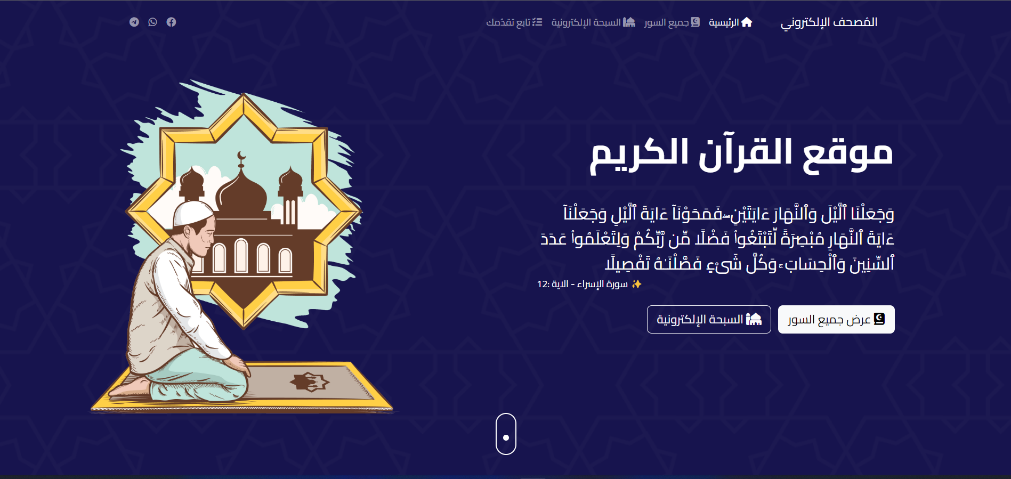
Header

Slide 9
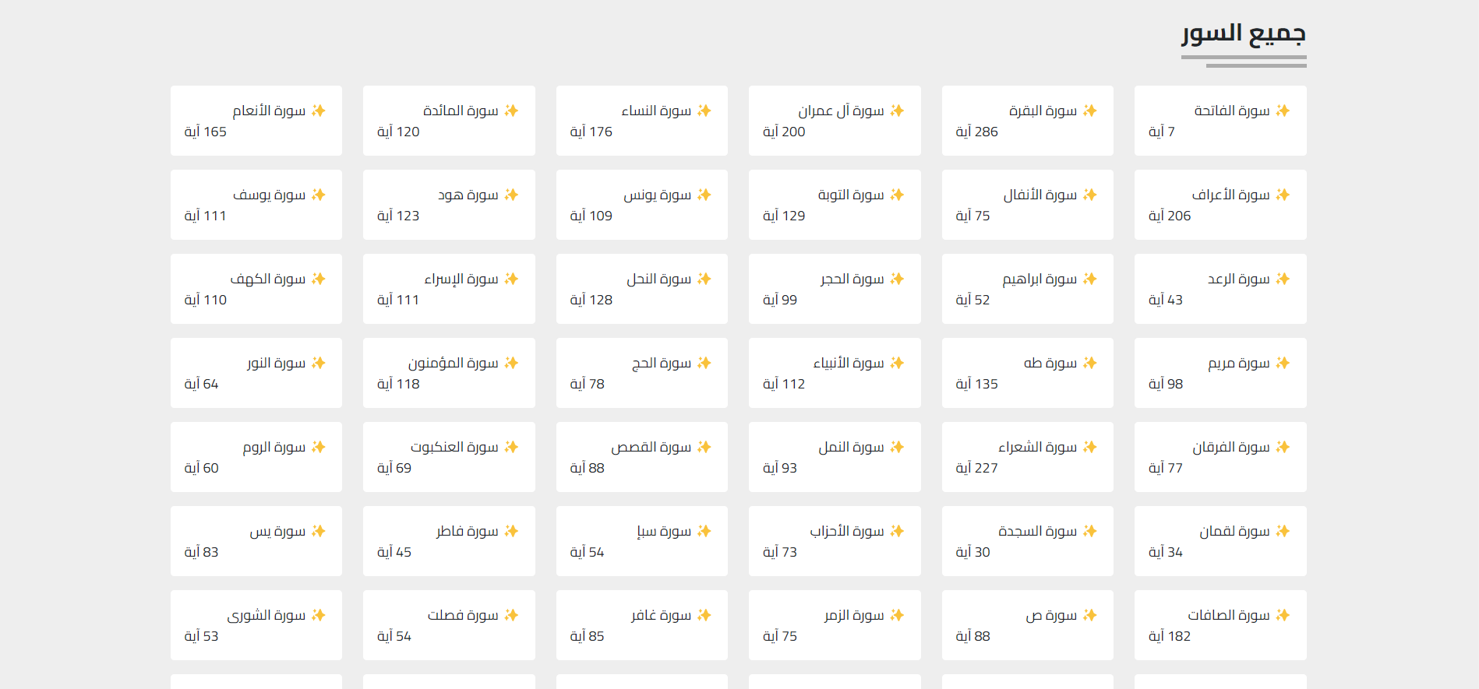

Slide 10
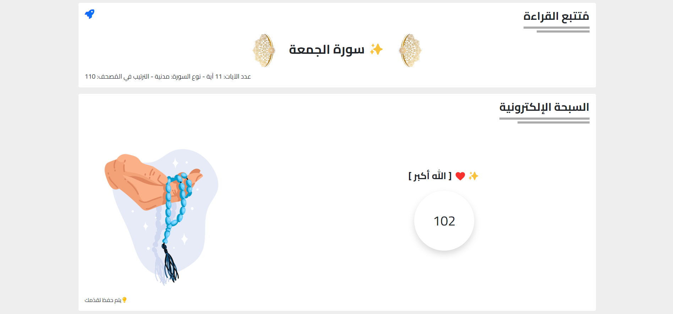

Slide 11
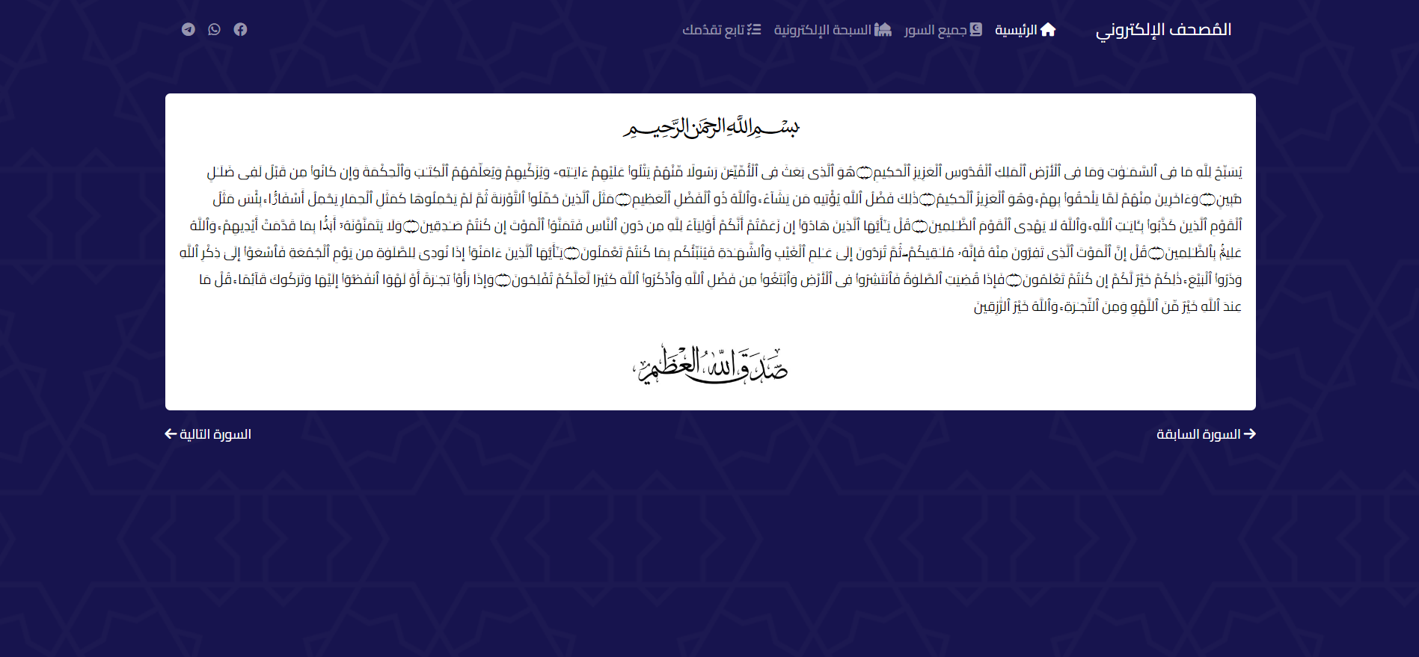

Slide 12
THANK YOU

